Slide 1
SQL Project Templates
You can use these templates in the project presentation for Analyze Data with SQL!
Copy the ones you'd like to use and write your own content.

Slide 2
Codeflix Churn Rate
Data Analysis
Analyze Data with SQL
George Kuzhikat
09-18-2020

Slide 3
Project Background
Four months into launching Codeflix, management asks you to look into subscription churn rates. It’s early on in the business and people are excited to know how the company is doing.
The marketing department is particularly interested in how the churn compares between two segments of users. They provide you with a dataset containing subscription data for users who were acquired through two distinct channels.
Your goal is to answer questions related to the company’s churn rate and develop a report!

Slide 4
Questions to Answer with our Data
What is the overall churn trend for 2017?
Which segment of users should the company focus on expanding?

Slide 5
1. Churn Rate Calculation

Slide 6
with months as (
SELECT
'2017-01-01' as first_day,
'2017-01-31' as last_day
UNION
SELECT
'2017-02-01' as first_day,
'2017-02-28' as last_day
UNION
SELECT
'2017-03-01' as first_day,
'2017-03-31' as last_day),
cross_join as
(select subscriptions.*, months.*
from subscriptions
CROSS JOIN
months),
Setting up the table
To calculate the churn rate, we need to arrange our table so the number of active subscribers and those who cancelled are visible. This data will be grouped by month and segment.
I programmed a temporary table to demonstrate churn rates for the first three months of 2017.

Slide 7
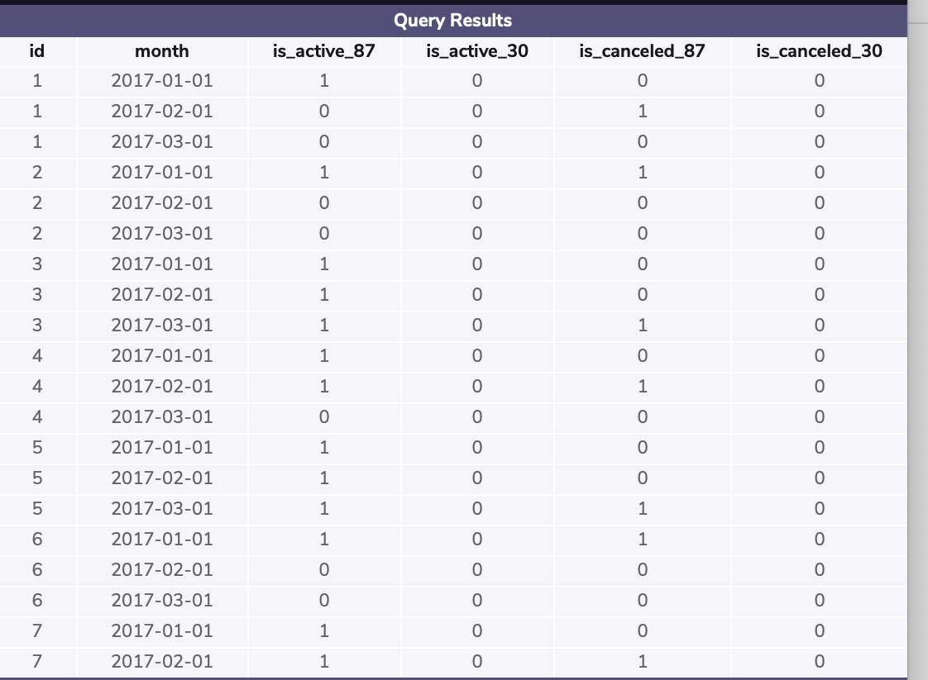
cross_join as
(select subscriptions.*, months.*
from subscriptions
CROSS JOIN
months),
status as (
select id, first_day as month,
CASE
WHEN (subscription_start < first_day) AND (subscription_end > first_day) AND (segment = 87)
OR subscription_end IS NULL
then 1
else 0
END AS is_active_87,
CASE
WHEN (subscription_start < first_day) AND (subscription_end > first_day) AND (segment = 30)
OR subscription_end IS NULL
then 1
else 0
END AS is_active_30,
CASE
WHEN(subscription_end between first_day and last_day) AND (segment = 87) then 1
else 0
END AS is_canceled_87,
CASE
WHEN(subscription_end between first_day and last_day) AND (segment = 30) then 1
else 0
end as is_canceled_30
from cross_join)
select * from status
limit 20;
Active and Canceled Subscribers
Now with the timeframe of our analysis established we can use SQL to create a is_active and is_canceled columns

Slide 8
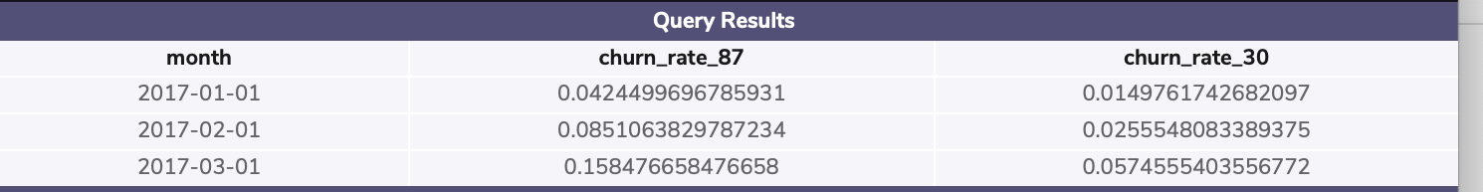
Now for the Churn Rate!
status_aggregate as
(
SELECT month, SUM(is_active_87) as sum_active_87,
sum(is_active_30) as sum_active_30,
sum(is_canceled_87) as sum_canceled_87,
sum(is_canceled_30) as sum_canceled_30
from status
group by month
)
select month, 1.0 * sum_canceled_87/sum_active_87 as churn_rate_87, 1.0 * sum_canceled_30/sum_active_30 as churn_rate_30 from status_aggregate;
So now we have the number of active and cancelled members for both segment 87 and segment 30 groups. We have our data grouped by month and for each ID.
Lets now aggregate our data to view churn rates for each segment groups and then group that data by month

Slide 9
2. What Does This Data Tell Us?

Slide 10
Conclusions
What is the overall churn trend since the company started?
We see a significant difference in churn rates between our segment groups which we will discuss later. In terms of months, both churn rates seem to increase as time goes on through the year. Churn rates from Jan-Mar have increased for both groups. This could be a sign to implement a loyalty or incentive program to keep members subscribed for a longer period.
2. Which segment of users should the company focus on expanding?
Our data shows us that segment 30 has a much lower churn rate than segment 87 every month we analyzed (Jan-Mar). This tells us that whatever marketing strategy was implemented for segment 30, its working well especially in comparison to the strategy implemented in segment 87.

